Slide 2
EUROPEAN PICNIC
2014
FELSONYEK
CROSS-BORDER ACTIONS
AGAINST
CROSS-BORDER THREATS

Slide 3
EUROPEAN PICNIC
2014
FELSONYEK
EUROPEAN PICNIC
2014
FELSONYEK

Slide 4
EUROPEAN PICNIC
2014
FELSONYEK
EUROPEAN PICNIC
2014
FELSONYEK
SUPPORTED BY EU EACEA „EUROPE FOR CITIZENS”

Slide 5
EUROPEAN PICNIC
2014
FELSONYEK
SUSTAINABLE
DEVELOPMENT
PLENARY INTRODUCTION

Slide 6
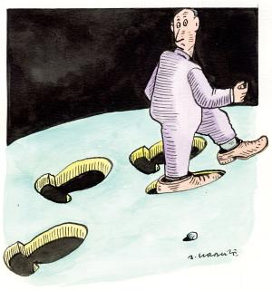
EUROPEAN PICNIC
2014
FELSONYEK

Slide 7
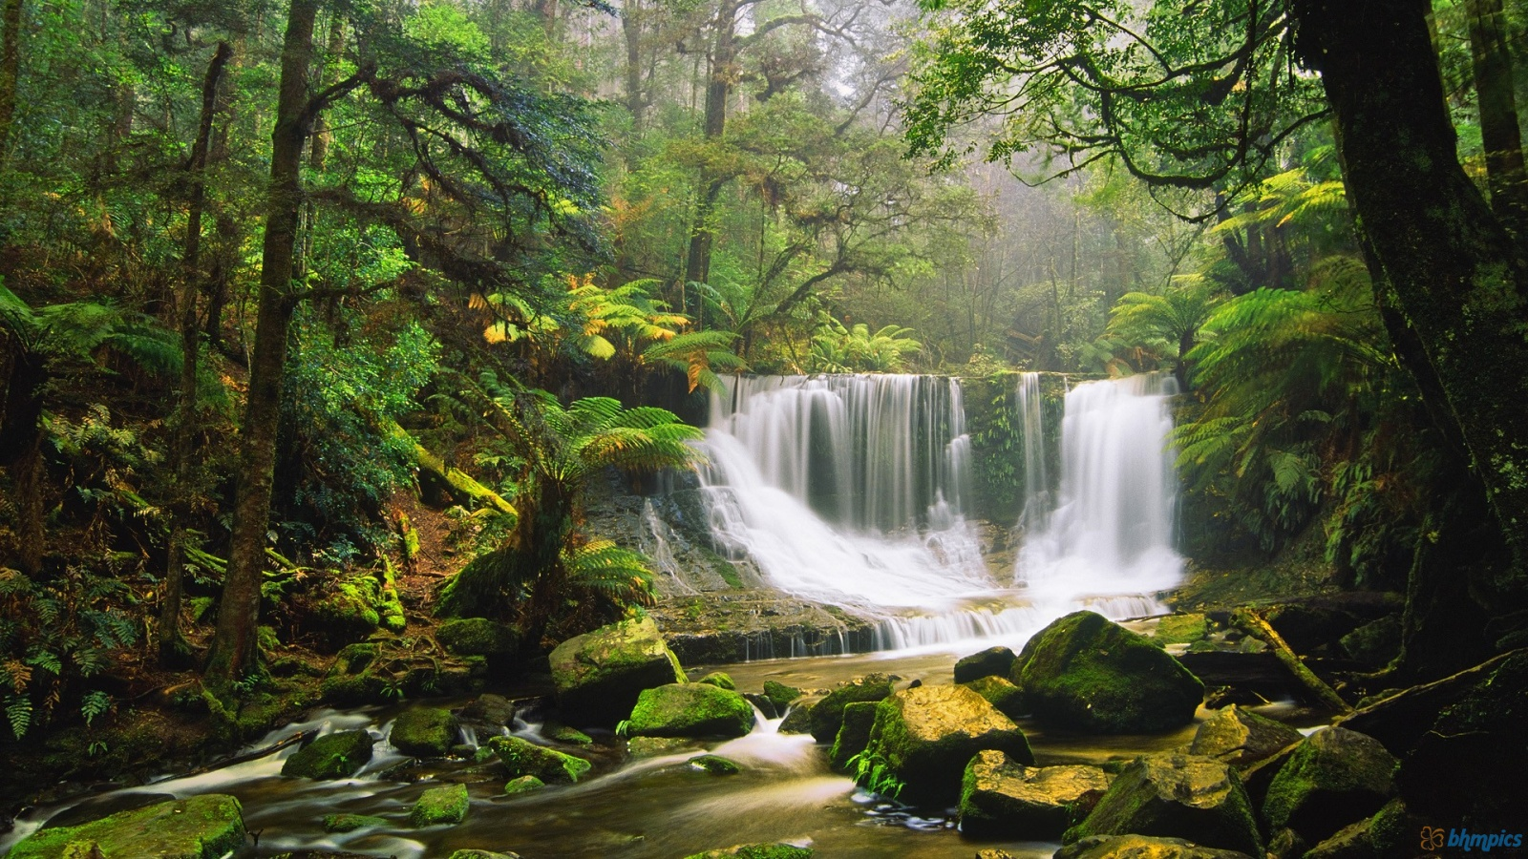
EUROPEAN PICNIC
2014
FELSONYEK

Slide 8
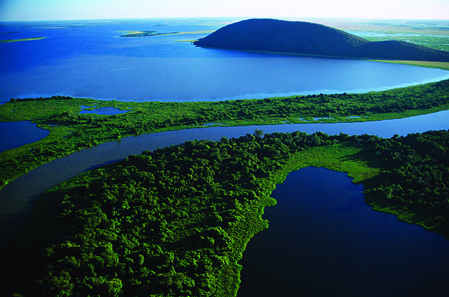
EUROPEAN PICNIC
2014
FELSONYEK

Slide 9
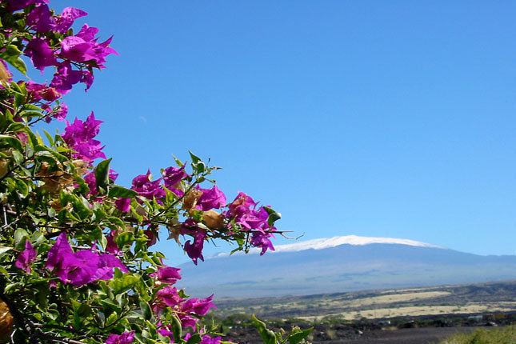
EUROPEAN PICNIC
2014
FELSONYEK

Slide 10
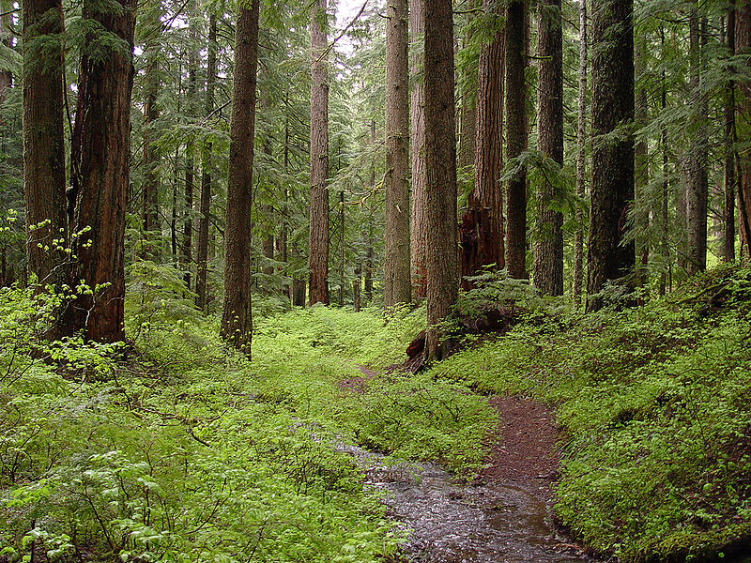
EUROPEAN PICNIC
2014
FELSONYEK

Slide 11
DEVELOPMENT
EUROPEAN PICNIC
2014
FELSONYEK
SOMETHING MORE
SOMETHING BETTER
THAN BEFORE

Slide 12
SUSTAINABLE
EUROPEAN PICNIC
2014
FELSONYEK
WE CAN REPEAT IT FORVER

Slide 13
EUROPEAN PICNIC
2014
FELSONYEK
RESOURCES

Slide 14
EUROPEAN PICNIC
2014
FELSONYEK
RESOURCES

Slide 15
EUROPEAN PICNIC
2014
FELSONYEK
RESOURCES
ACTION (DEVELOPMENT)

Slide 16
EUROPEAN PICNIC
2014
FELSONYEK
RESOURCES
ACTION (DEVELOPMENT)

Slide 17
EUROPEAN PICNIC
2014
FELSONYEK
RESOURCES
SUSTAINABLE
ACTION (DEVELOPMENT)

Slide 18
EUROPEAN PICNIC
2014
FELSONYEK
RESOURCES
SUSTAINABLE
ACTION (DEVELOPMENT)

Slide 19
EUROPEAN PICNIC
2014
FELSONYEK
RESOURCES
ACTION (DEVELOPMENT)

Slide 20
EUROPEAN PICNIC
2014
FELSONYEK
RESOURCES
NON
SUSTAINABLE
ACTION (DEVELOPMENT)

Slide 21
EUROPEAN PICNIC
2014
FELSONYEK
RESOURCES
NON
SUSTAINABLE
ACTION (DEVELOPMENT)

Slide 22
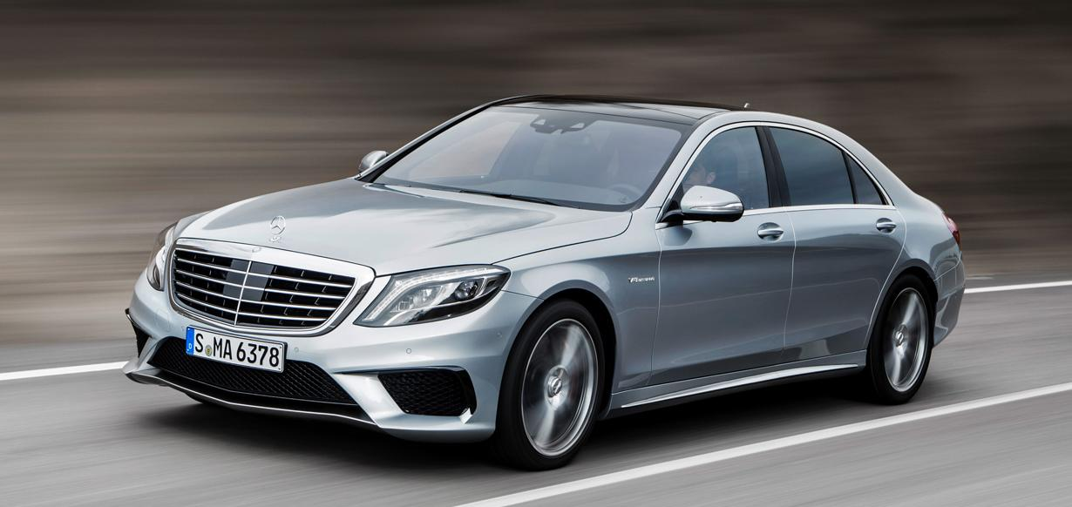
EUROPEAN PICNIC
2014
FELSONYEK

Slide 23
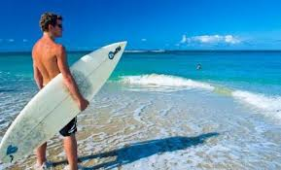
EUROPEAN PICNIC
2014
FELSONYEK

Slide 24
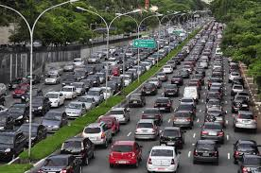
EUROPEAN PICNIC
2014
FELSONYEK

Slide 25
?
EUROPEAN PICNIC
2014
FELSONYEK

Slide 26
EUROPEAN PICNIC
2014
FELSONYEK

Slide 27
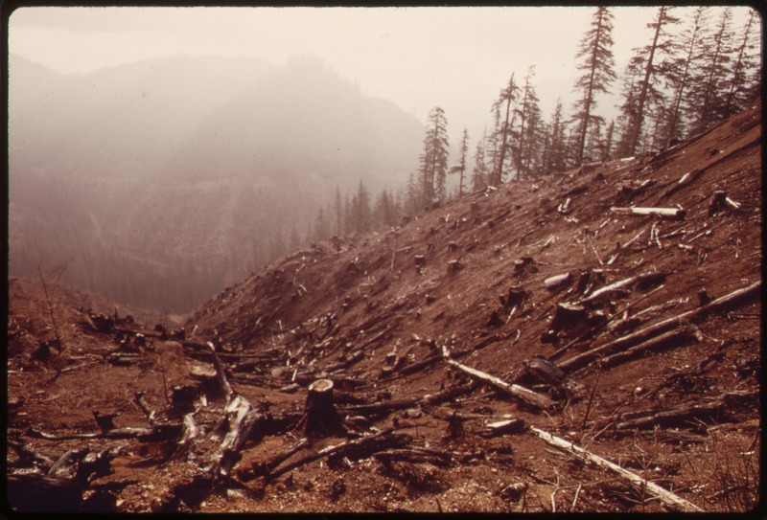
EUROPEAN PICNIC
2014
FELSONYEK

Slide 28
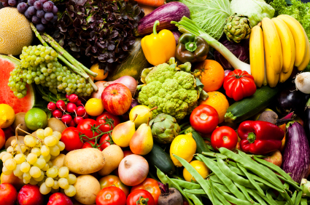
EUROPEAN PICNIC
2014
FELSONYEK

Slide 29
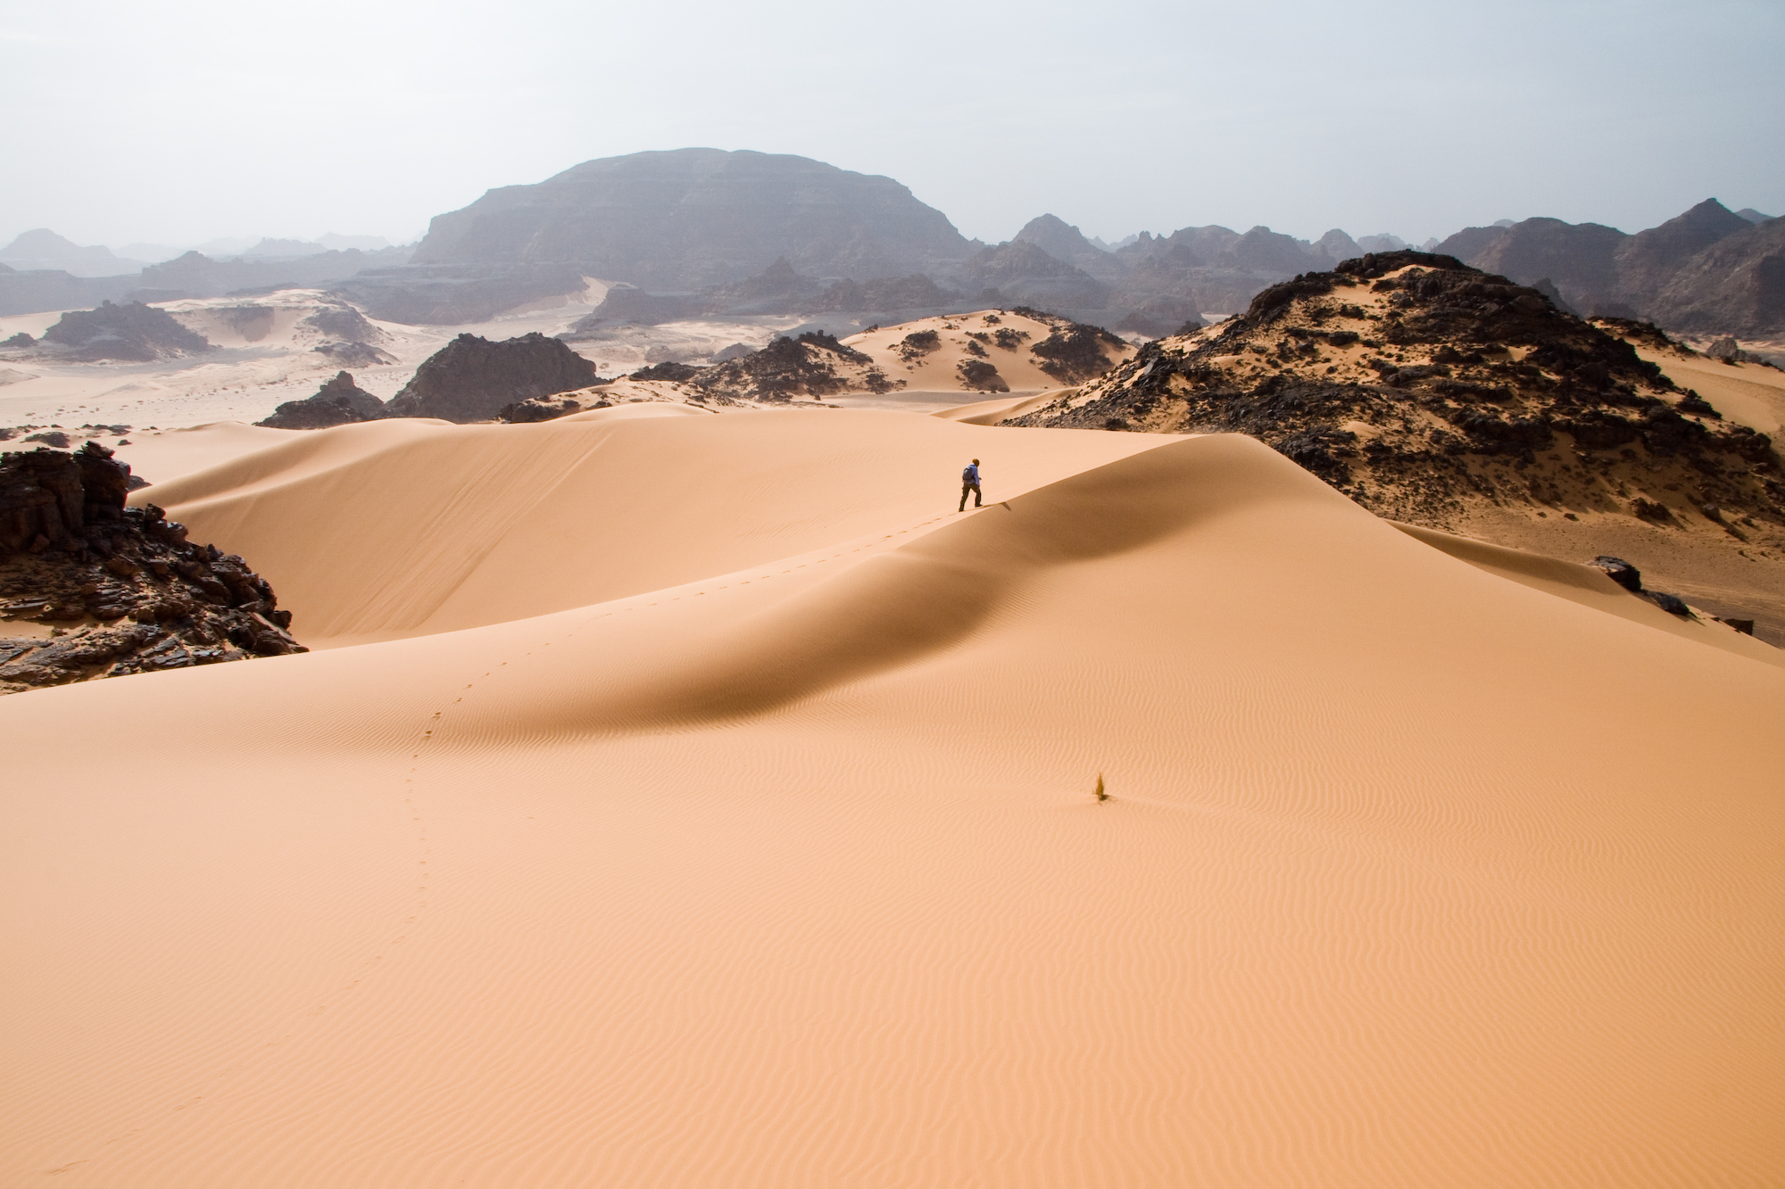
EUROPEAN PICNIC
2014
FELSONYEK

Slide 30
?
EUROPEAN PICNIC
2014
FELSONYEK

Slide 31
EUROPEAN PICNIC
2014
FELSONYEK

Slide 32
?
EUROPEAN PICNIC
2014
FELSONYEK

